Slide 1
Announcements
Homework 5 due tonight (11:59pm) via Carmen
Homework 6 out now: Due 12/1 @ 11:59pm

Slide 2
Today’s learning goals
At the end of today, you should be able to
Describe AI applications to image classification and gestural control
Describe AI applications to problems in robotics

Slide 3
Information retrieval
Flip side of information extraction
Input
Query (structured data or unstructured text)
Output
List of records (documents), ranked by relevance to query
“Information about platypi”
IR

Slide 4

Example

Slide 5
IR is more than just language
Information retrieval can be mostly structured
E.g., PageRank (Google’s early search algorithm)
Uses page connections via hyperlinks to define “important” pages
Does some keyword-based matching
Or mostly unstructured
Example medical document retrieval system:
Query: string of disease names (”emphysema, breast cancer, diabetes”)
Method: find documents that frequently mention these words
Rank by date entered (recent first)

Slide 6

IR example
Query: “emphysema AND diabetes”
Extra knowledge base info:
“chronic cough” is related to “emphysema”
“insulin” is related to “diabetes”
Document | F(emphysema) | F(diabetes) | F(cough) | F(insulin)
D1 | 14 | 0 | 2 | 0
D2 | 0 | 3 | 1 | 4
D3 | 0 | 0 | 0 | 0
D4 | 10 | 7 | 12 | 6

Slide 7
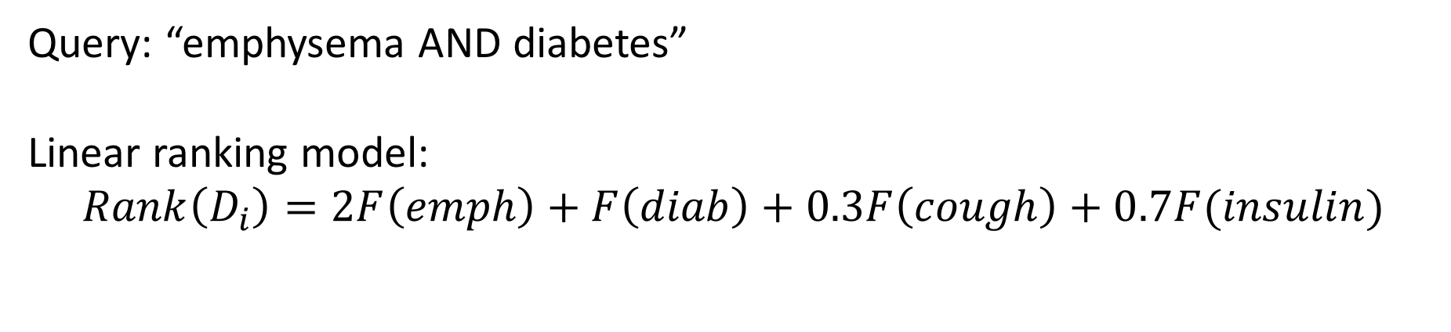
IR example
Query: “emphysema AND diabetes”
Linear ranking model:
$$Rank\left(D_{i}\right)=2F\left(emph\right)+F\left(diab\right)+0.3F\left(cough\right)+0.7F(insulin)$$
Document | F(emphysema) | F(diabetes) | F(cough) | F(insulin) | Score
D1 | 14 | 0 | 2 | 0 | 28.6
D2 | 0 | 3 | 1 | 4 | 6.1
D3 | 0 | 0 | 0 | 0 | 0
D4 | 10 | 7 | 12 | 6 | 34.9
Return documents in ranked order: [D4, D1, D2, D3]

Slide 8
Sample IR experimental questions
How does a unigram (1-word) frequency model compare to a bigram (2-word) model?
How important are hyperlinks vs text matches?
Does my new way of representing documents give me better IR generalization to different kinds of documents?
How do I efficiently rank tens of millions of documents?

Slide 9
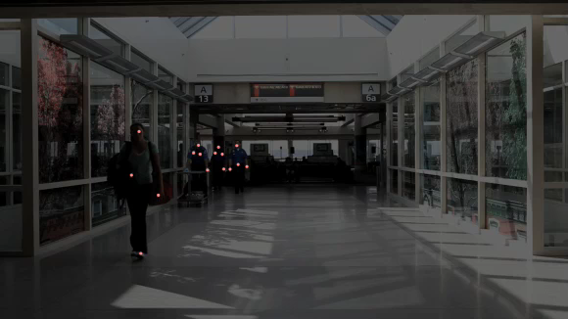
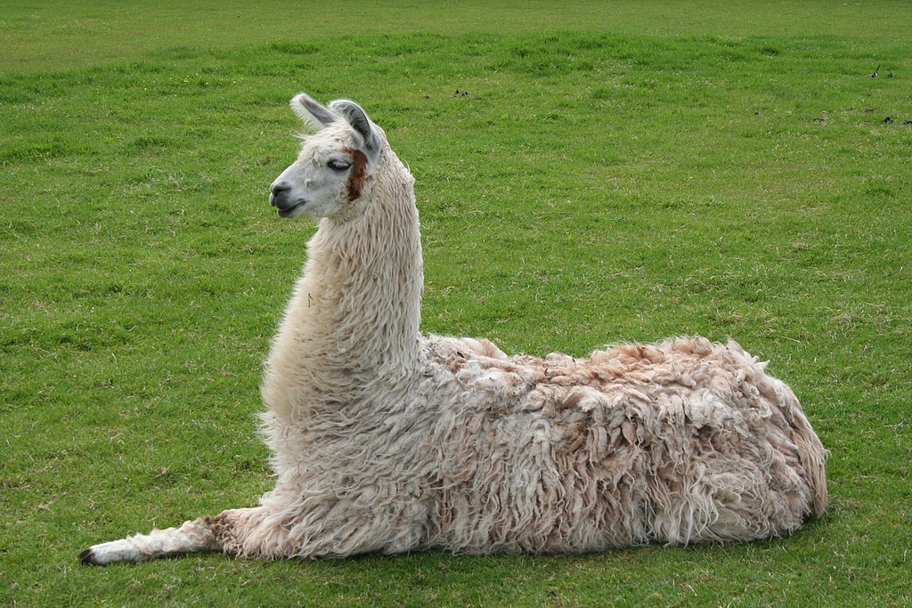
Computer vision
Video from Joshua Mosley

Slide 10
Vision data
Data come in different forms
Single images
Video (image sequence)
Grayscale/RGB/CMYK/etc
Multiple cameras
Other factors in data
Lighting
Distance to subject
Lens shape
as
etc.

Slide 11
Vision applications
Image classification
Motion tracking
Motion capture
Gestural control
Sports highlights/analysis
…

Slide 12
Image classification
Input
Single image
Classifier
Output
Label(s) describing image content
Llama

Slide 13
Feature extraction – edge detection
Use pixel value gradients to find sharp changes
Thresholding for a certain value gives you edges
Original
Edges
Overlaid
Images from Jim Davis

Slide 14
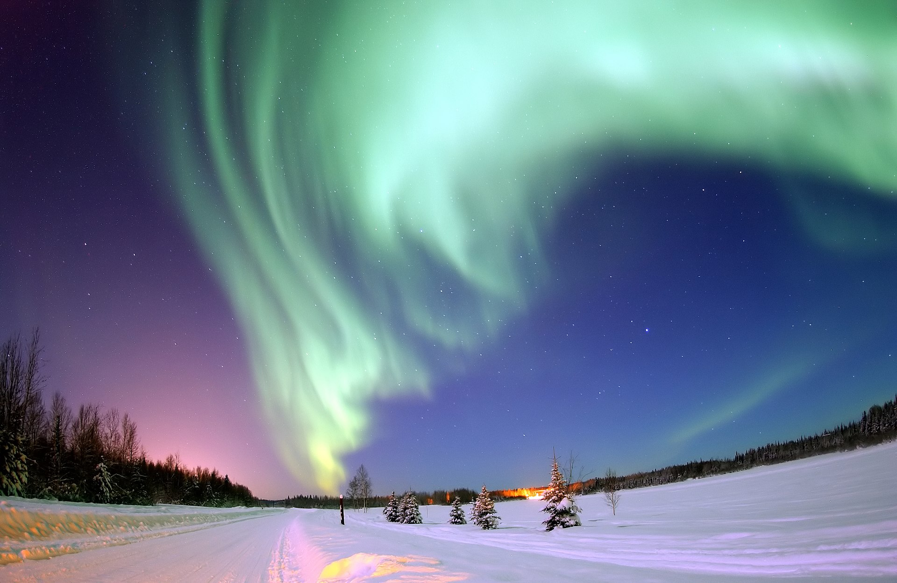

Feature extraction – region segmentation
Break the image into contiguous regions
Can use clustering methods like k-means
k-means (k=16)
Original
Segmented

Slide 15
Convolutional Neural Networks
Say we want to learn to extract useful features for classification
May be edges, faces, color patterns, etc
Use a neural network to get arbitrary image features

Slide 16
Convolutional neural networks
Normal fully-connected neural net
Linear combination of every single pixel in the image
Way too many parameters!

Slide 17
Convolutional neural networks
Use local connections instead
Important information w.r.t. one pixel is usually nearby
Local statistics can be similar at different locations
A nose is a nose
Translation invariance
So slide local “windows” around the image

Slide 18
Convolutional operation (single 3x3 filter)
Images from Jim Davis

Slide 19
Convolutional operation (single 3x3 filter)
Images from Jim Davis

Slide 20
Convolutional operation (single 3x3 filter)
Images from Jim Davis

Slide 21
Convolutional operation (single 3x3 filter)
Images from Jim Davis

Slide 22
Convolutional operation (single 3x3 filter)
Images from Jim Davis

Slide 23
Convolutional operation (single 3x3 filter)
Images from Jim Davis

Slide 24
Different filters for different features
Use many different filters over the same image
Each filter is just a linear combination of pixels
Parameters are the same no matter where you apply
Ideally, each learns different features
Llama faces, color shifts, noses, etc.

Slide 25
Actually doing image classification
General process:
Extract features from labeled images
Plug them into some classification model
Logistic regression
Neural network
Support Vector Machine, etc
Profit
Features
Classifier
Llama

Slide 26
Experimental questions for image classification
Which features work best for different classification tasks?
Labeling animals, night vs day, city where image was taken, etc.
Can I automatically find the best threshold for edge detection on pictures of faces?
…

Slide 27
Gestural control
Main idea: use hand gesture input to control computer applications
Track user’s hand in 3D
Pre-defined gestures act as discrete computer commands
One or more cameras
Need real-time processing!
Slides adapted from Jim Davis

Slide 28
Simple example
3 kinds of gestures:
Point, Reach, and Click
Recognize using edges of hand against background
Track how edge shape changes between video frames
Example from Kumar and Segen (1999)
Slides adapted from Jim Davis

Slide 29
Application 1: Flight simulator
Example from Kumar and Segen (1999)
Slides adapted from Jim Davis

Slide 30
Application 2: Doom

Slide 31
Modern application
Toshiba concept demo (2009)
Combination of intelligent heuristics (tracking the hand) and learning (classifying gestures)

Slide 32
Robotics
More Youtube (new robot dog)

Slide 33
Robotics
What kinds of problems do you have to deal with?
Physical environment: partially observable, full of stuff
Physical components: unreliable, may fail
Sensors: limited ability to perceive environment
Two examples of very different robotics settings: Industrial robotics and swarm robotics

Slide 34
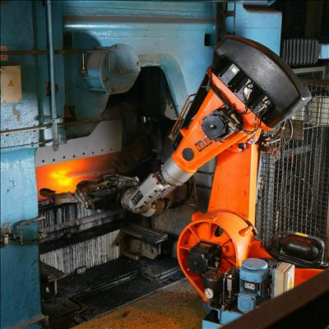
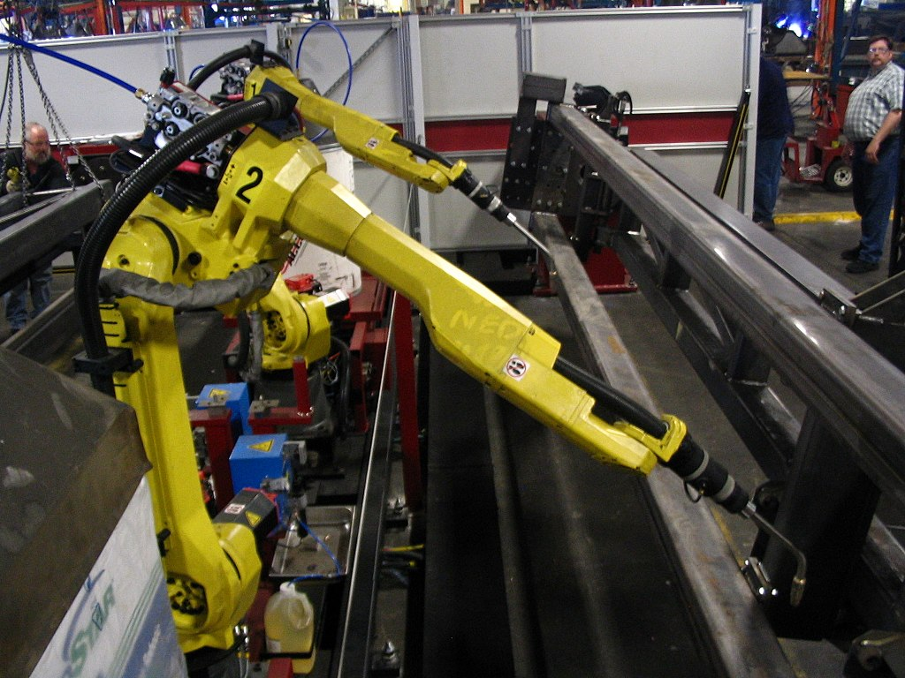
Industrial robotics

Slide 35
Industrial environments
Controlled environment
Agent typically has limited or no movement
Know what other agents (robots, humans) will be around
Know what physical conditions should be

Slide 36
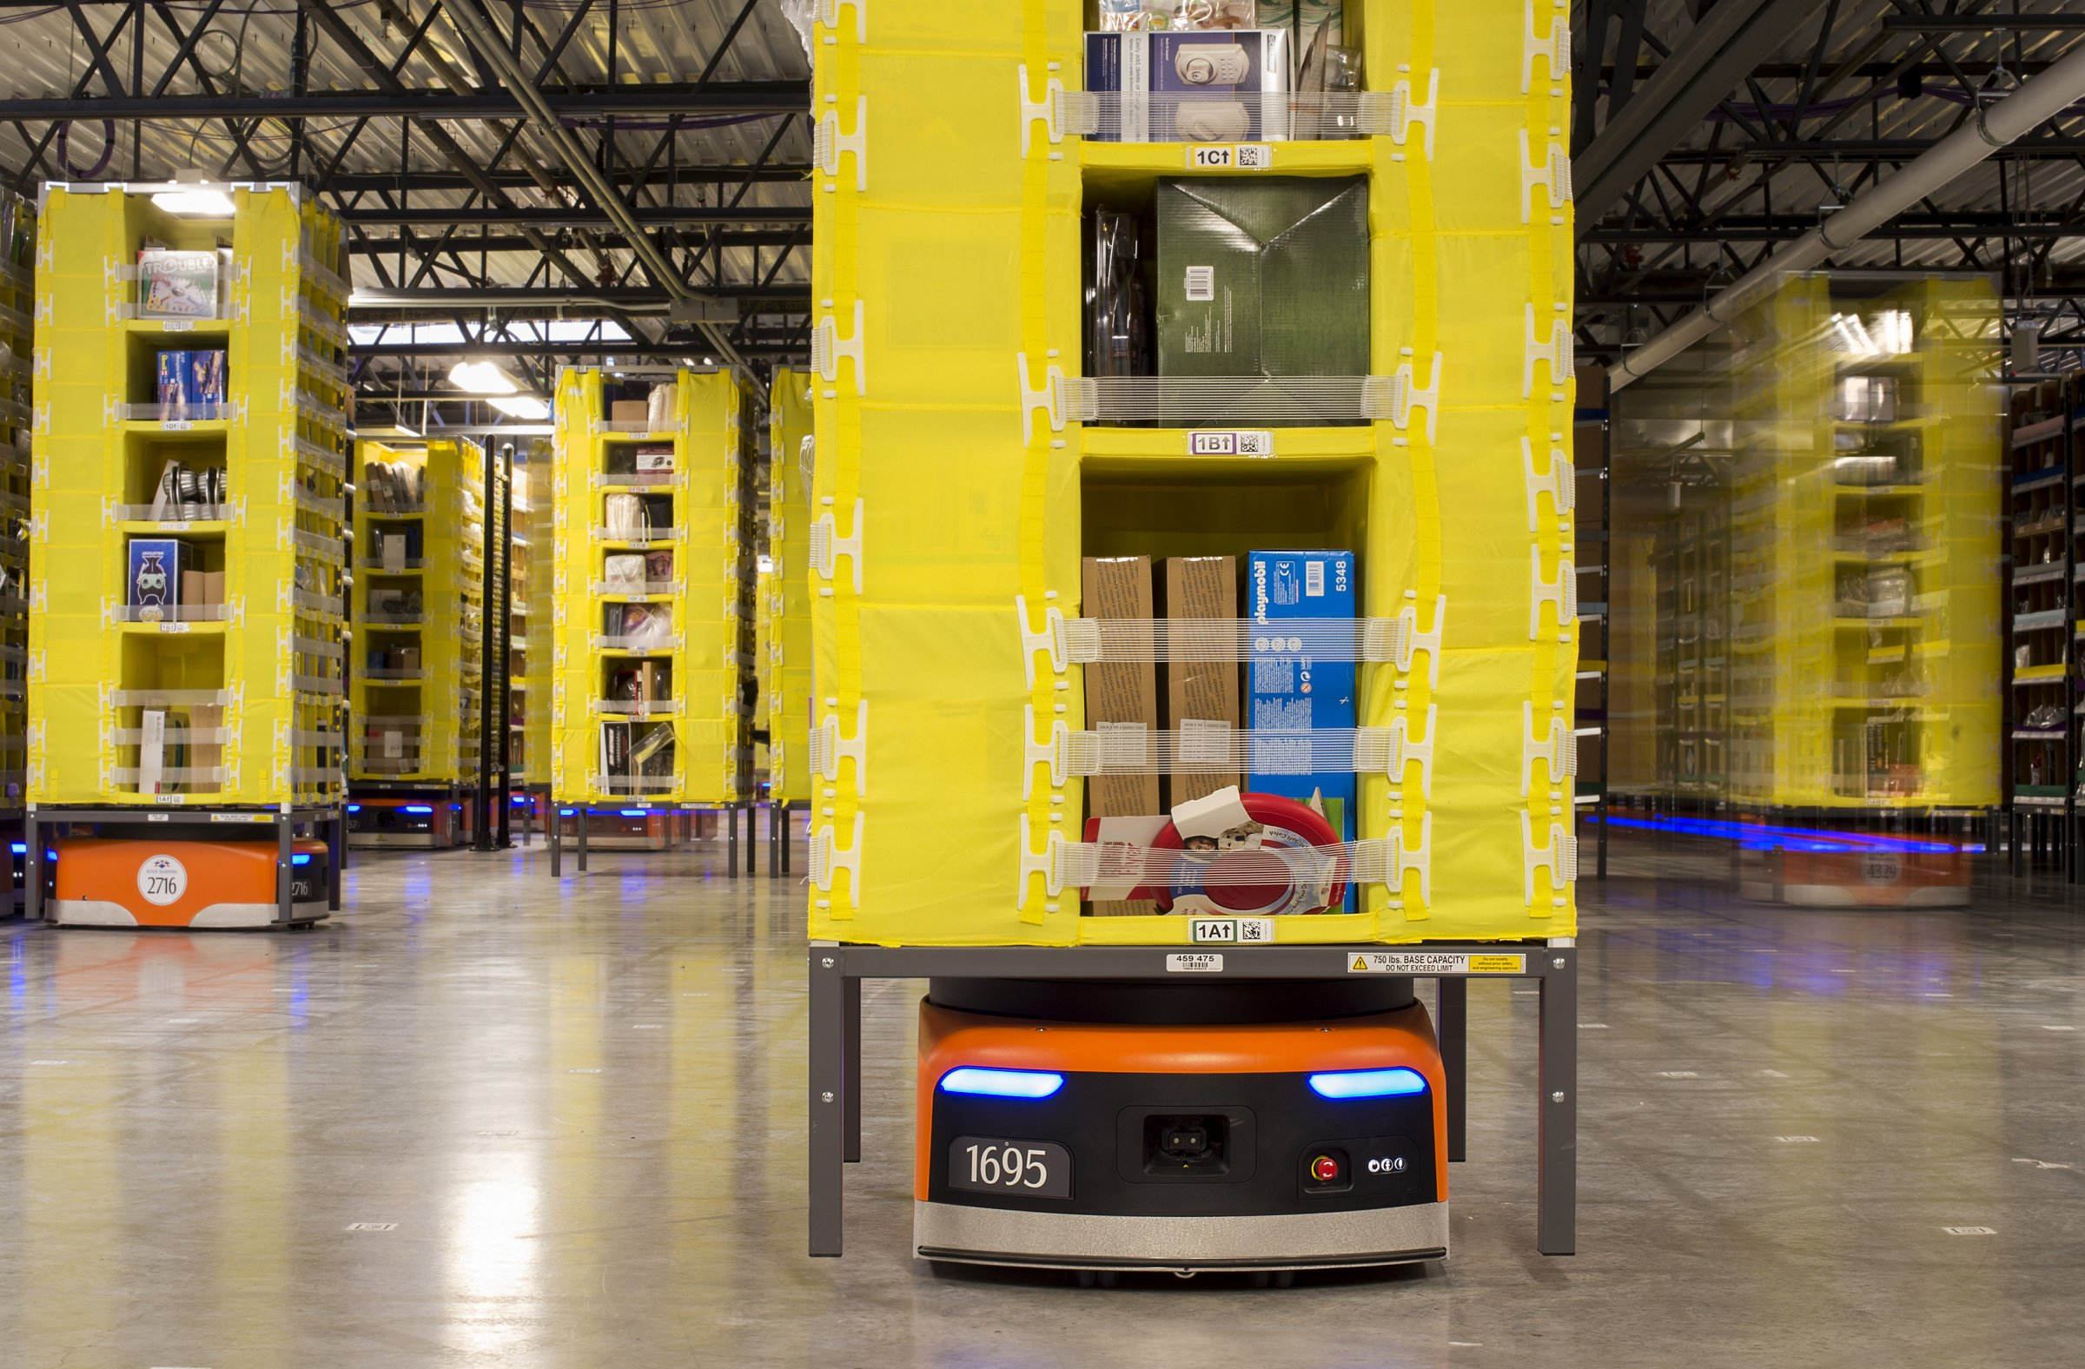
Industrial applications
Applications/autonomy vary
Highly specialized for a single task with hard input/output constraints
Pre-defined routines, no agency
Bottling, welding, etc
Multiple tasks or variable environment; multi-agent
Some conditional behavior, possibly learning routines
Warehouse robots
Reuters

Slide 37
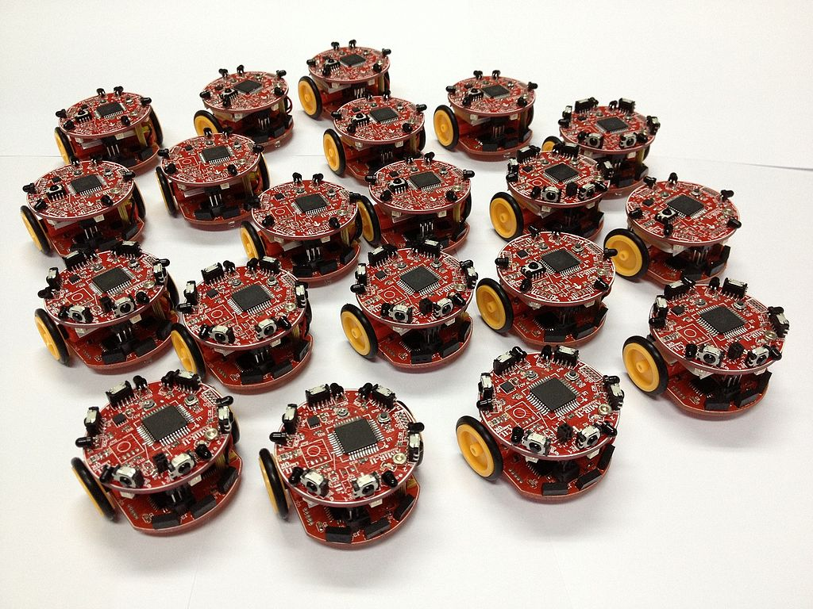
Swarm robotics
Hundreds of small robots operating together
Each agent has
Limited (and noisy) sensors
Very limited compute capability
Communication with other agents
General idea: support complex environment interaction with minimal resources

Slide 38
Swarm robotics
Demo

Slide 39
Very different problems from industrial
Highly controlled environment
Complex actuators
Special-purpose sensors
Open environment
Very simple actuators
Simple, general sensors

Slide 40
Multi-agent systems
For each agent, environment includes many other agents
All agents act concurrently, must predict what others will do
One solution: single overall controller
Problem: inflexible, hard to maintain
Better solution: minimax-like
Problem: too many other agents! And not turn-based.
Best solution: robust to unexpected outcomes (bumps)

Slide 41
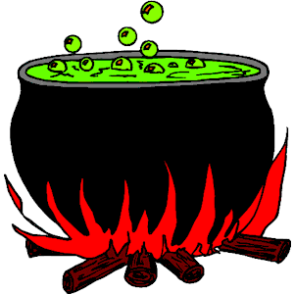
Application notes: Problems mix together
Information retrieval gets easier and faster when you have good information extraction
Errors in POS tagging mean errors farther down the line in information extraction or other applications
Speech recognition requires good (text-based) language modeling

Slide 42
Many problems span multiple areas
One popular task: image captioning
Requires both good vision and language components

Slide 43
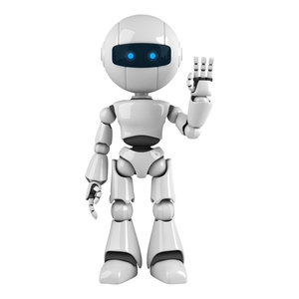
Robotics: combining everything
A general-purpose, learning robot needs to combine many tasks
Perception: vision, speech recognition
Understanding/answering: information retrieval, language generation
Acting: reinforcement learning, probabilistic modeling

Slide 44
Next time
AI philosophy: Chinese room and society of mind

